Slide 1

USING RESERVOIR COMPUTING TO PREDICT A MEMRISTIVE CHAOTIC SYSTEM
Presented by ADETAYO MATHEW TEMITOPE
Supervised by DR KS OJO

Slide 2
OVERVIEW
Many systems exhibit chaos however they’ve remained difficult to model up till now.
One thing reservoir reservoir computing can do is give us new ability to understand these sytems.

Slide 3
Central Ideas
What is chaos? small changes can lead to vast differences in a system over time. think of the butterfly effect.
What is a memristive system? a memristive system is a class of nonlinear dynamical systems whose resistance depends on the history of the current or voltage applied to them. the concept was first introduced by chua 1971, who introduced the memristor as the fourth fundamental circuit element.
What is reservoir computing? an extension of artificial neural networks where only the output weights are changed
What is the aim of this project? to use machine learning (reservoir computing) to model and predict the system’s behavior over time.

Slide 4
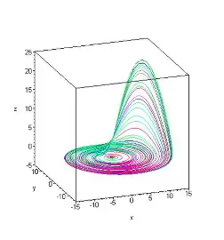
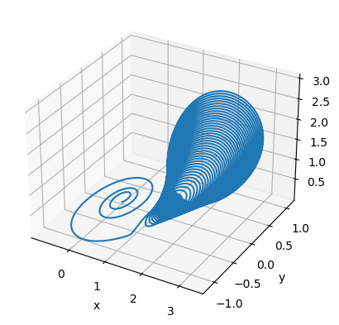
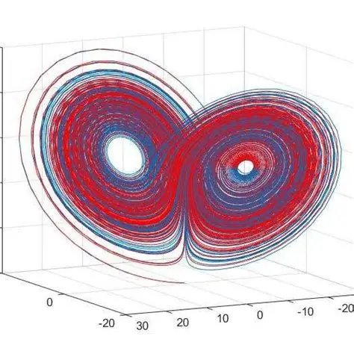
Some chaotic attractors examples

Slide 5
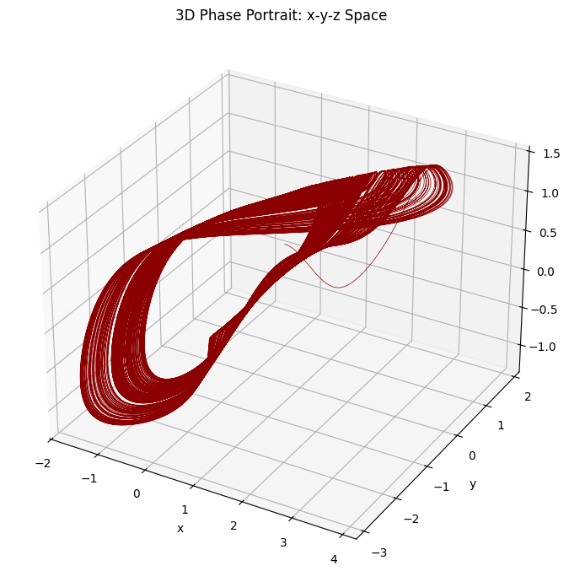

The memristive system
$x˙=y+ytan(z),$
$y˙=tan\left(z\right)$3.1
$z˙=xW\left(u\right)+arctan\left(z\right),$
$u˙=x,$

Slide 6
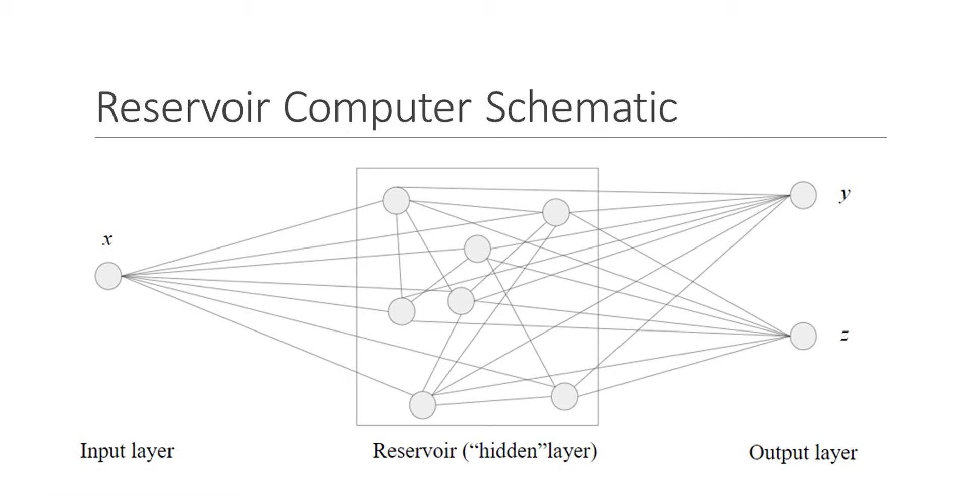

Slide 7
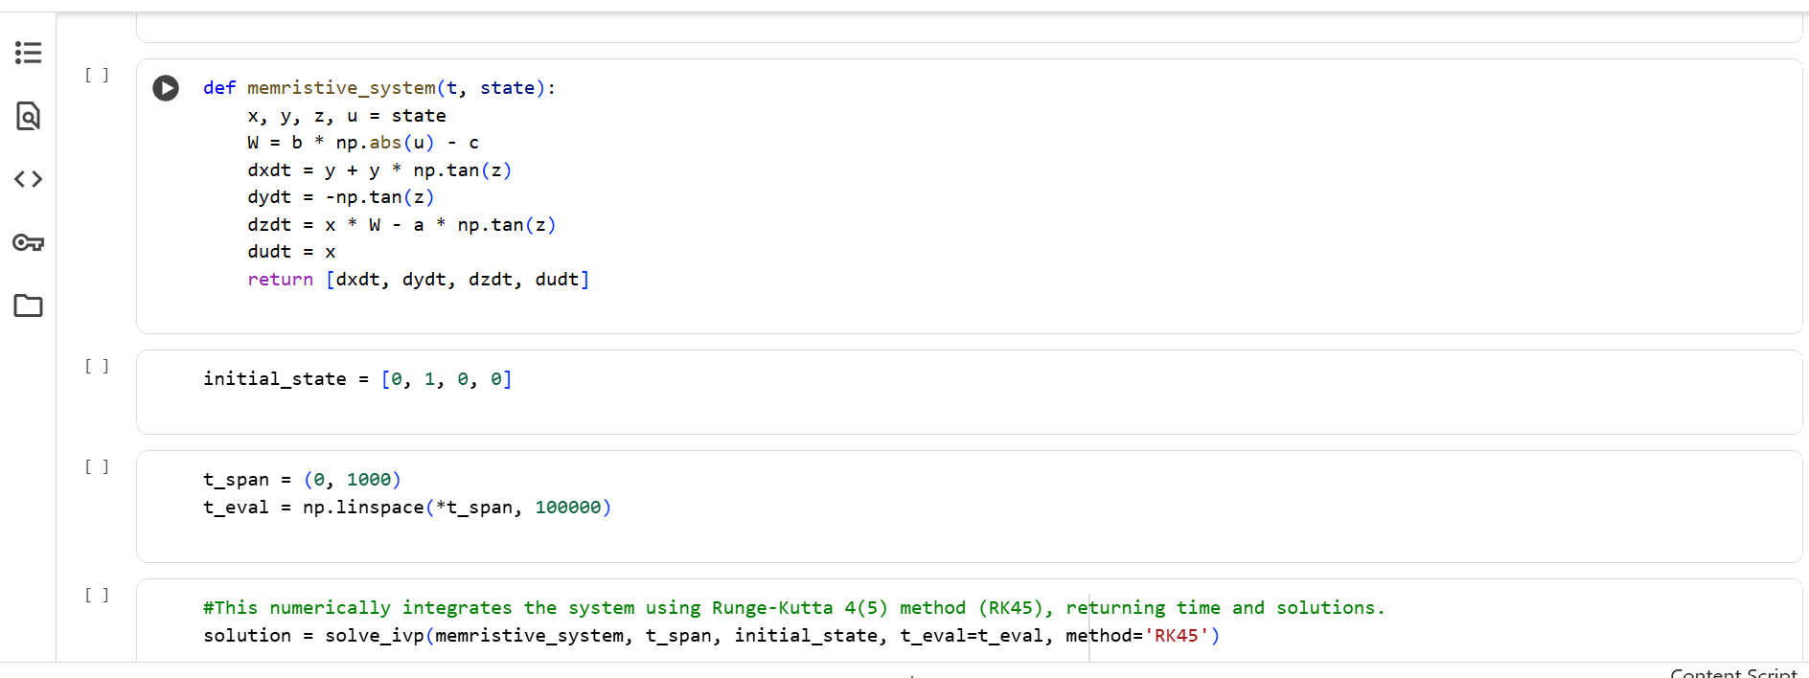
METHOD
Memristive chaotic systems, such as the one considered in this paper, are described by systems of coupled nonlinear differential equations. In most cases, these equations will be difficult and tedious and practically impossible to solve analytically due to their nonlinearity and complexity. Therefore, numerical methods are employed to approximate their trajectories and explore their dynamical behaviors

Slide 8
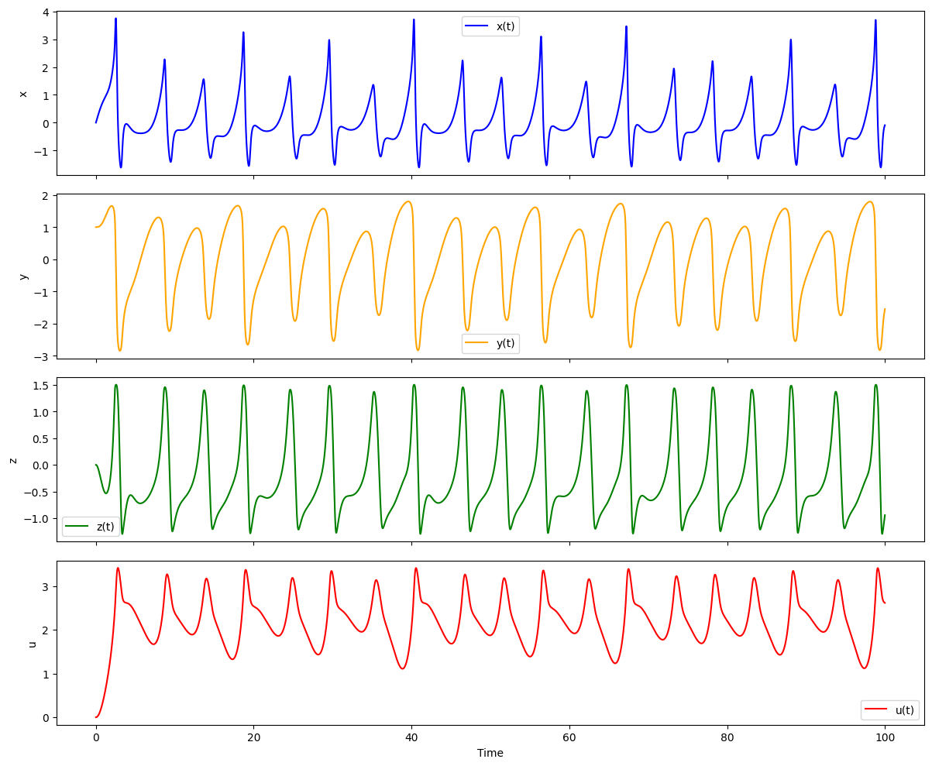
Results – Observation Tasks

Slide 9
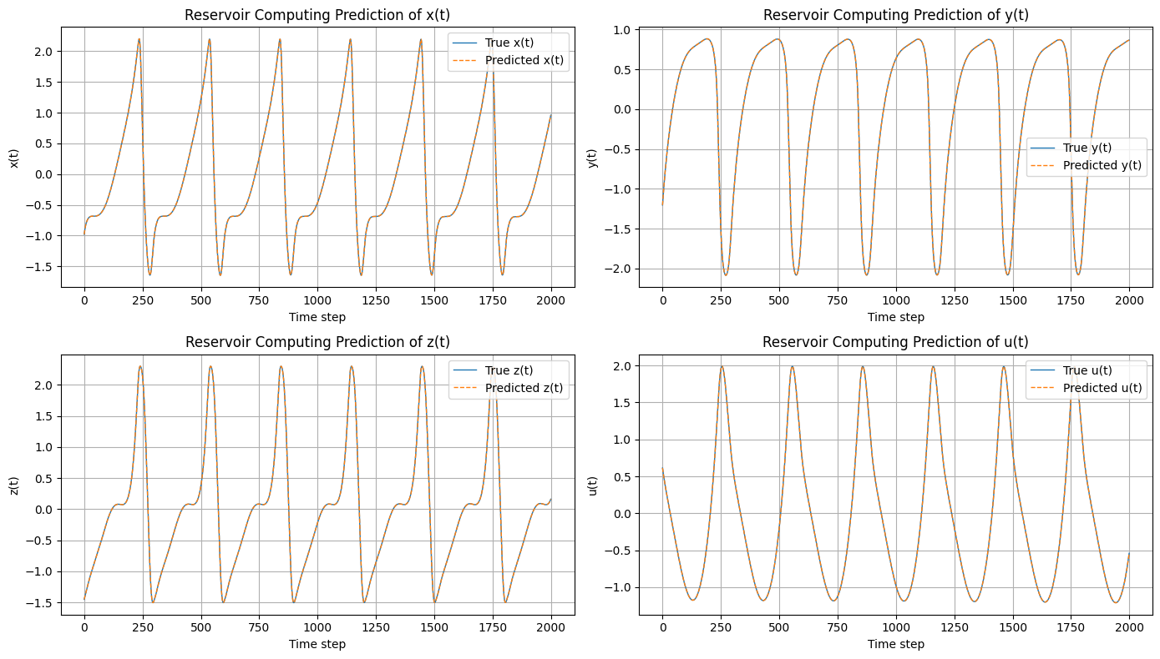
Results – Predictions

